Slide 1


MOLECULAR METHODS IN PHYTOPLANKTON RESEARCH
- OVERVIEW OF METHODOLOGIES, ADVANTAGES AND DRAWBACKS -
Catarina Churro
SHAREMED International Workshop
Connecting marine research and boosting benefits to society
| MALTA | 13.09.2022
Programme co-financed by the
European Regional Development Fund
Programa co-financiado pelo Fundo Europeu para o Desenvolvimento Regional

Slide 2

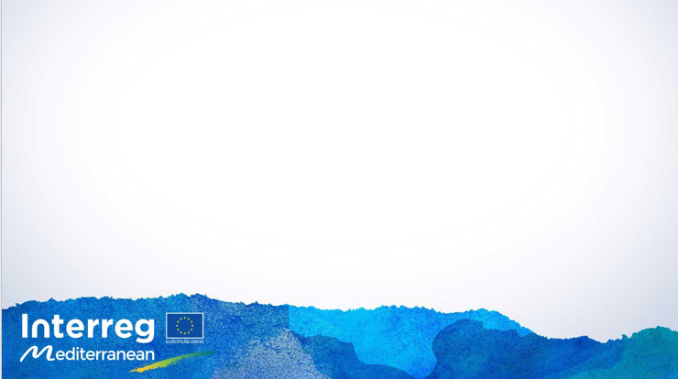
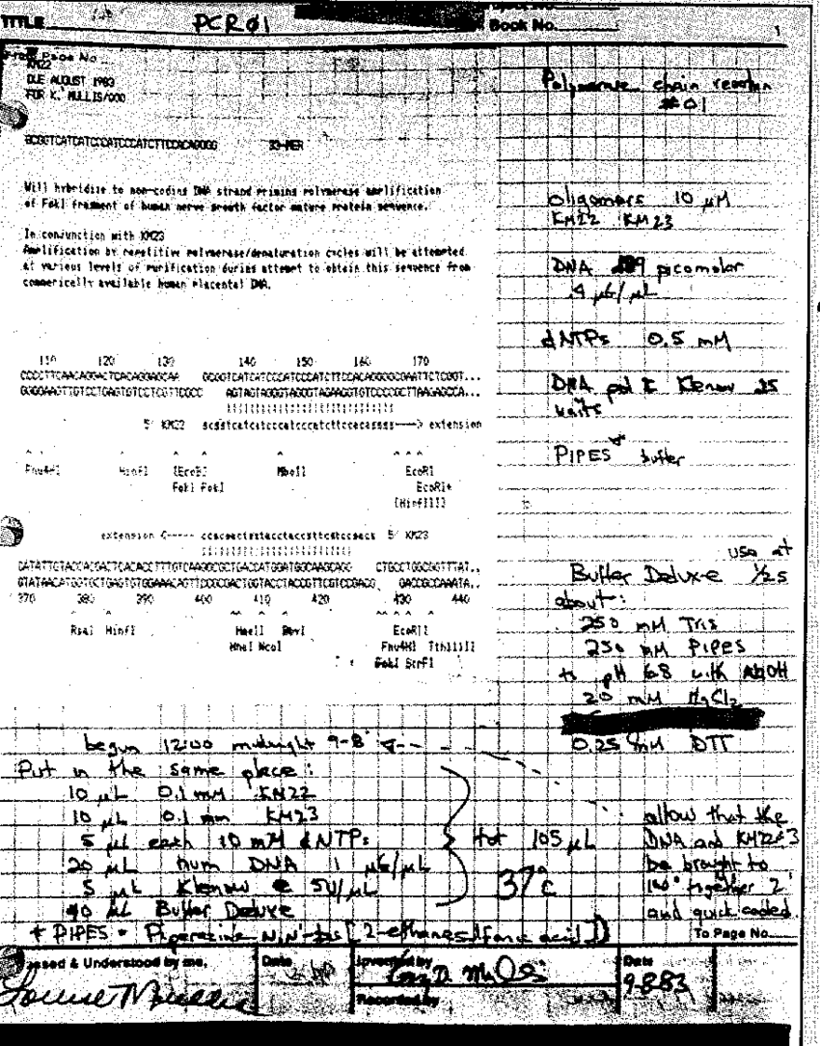
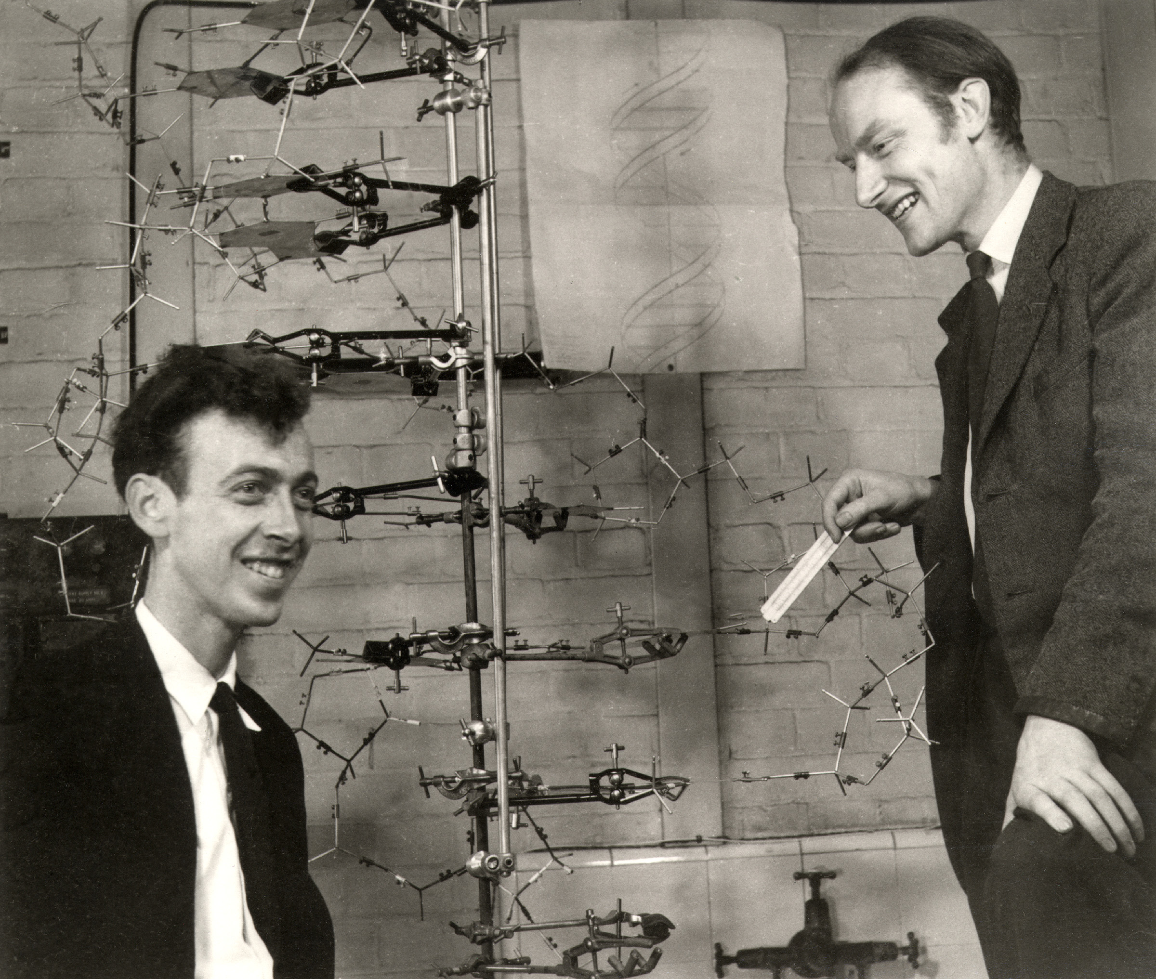
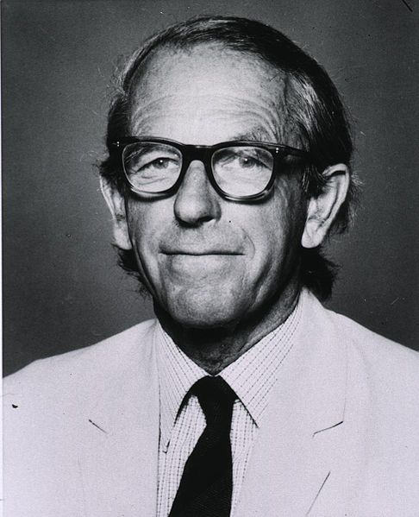
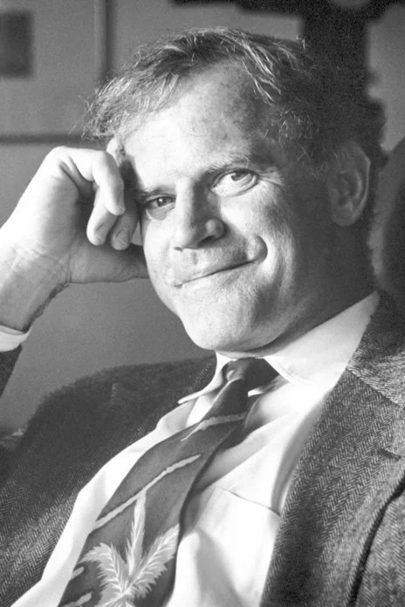
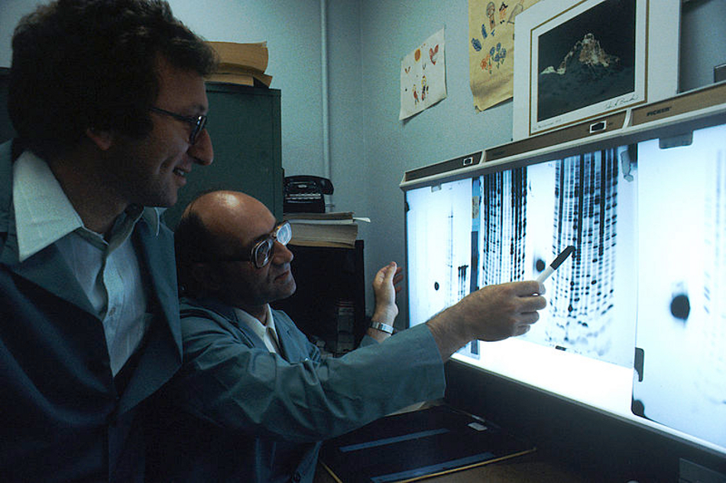
THE ERA OF DNA
PCR reaction
Structure
Sequencing
Frederick Sanger, 1977
Kary B. Mullis, 1983
Watson e Crick, 1953
[https://www.bbc.com/portuguese/geral-61393662]
First PCR reaction
[Müller et al. 2002 - DOI:10.1159/000066659]
[https://www.nobelprize.org]

Slide 3
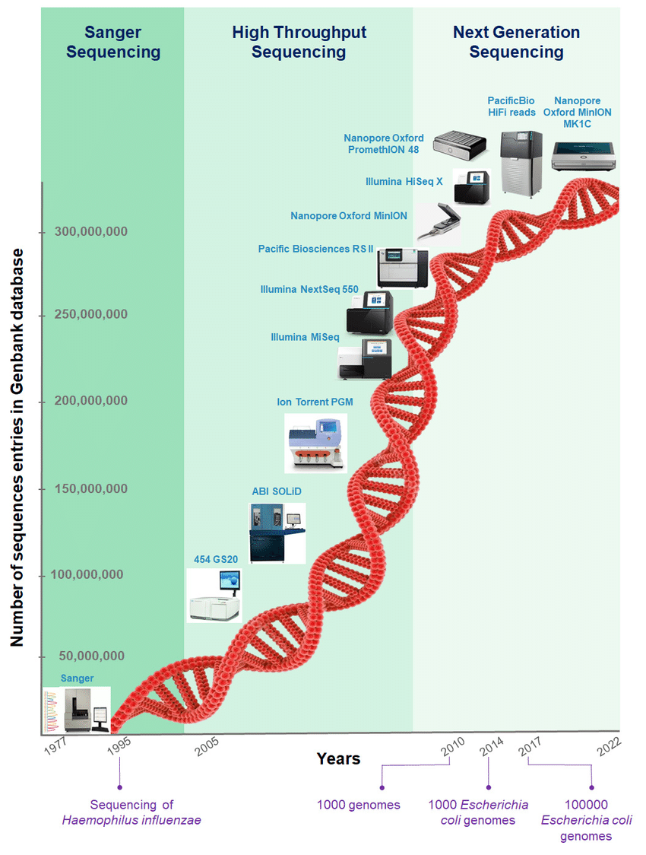
THE ERA OF DNA
MONITORING
[Khedher et al. 2022 DOI:10.3390/ijms23031395]

Slide 4
Ecosystem productivity
PHYTOPLANKTON
HABs
DIVERSITY
Organisms composition
Interactions
Ecotype
Cryptic species
Natural products
Strain
Toxins
Ecosystem Functioning
Human health
Species identification
MONITORING
Species detection
Population dymanics
Invasive species
Ecosystem services.

Slide 5
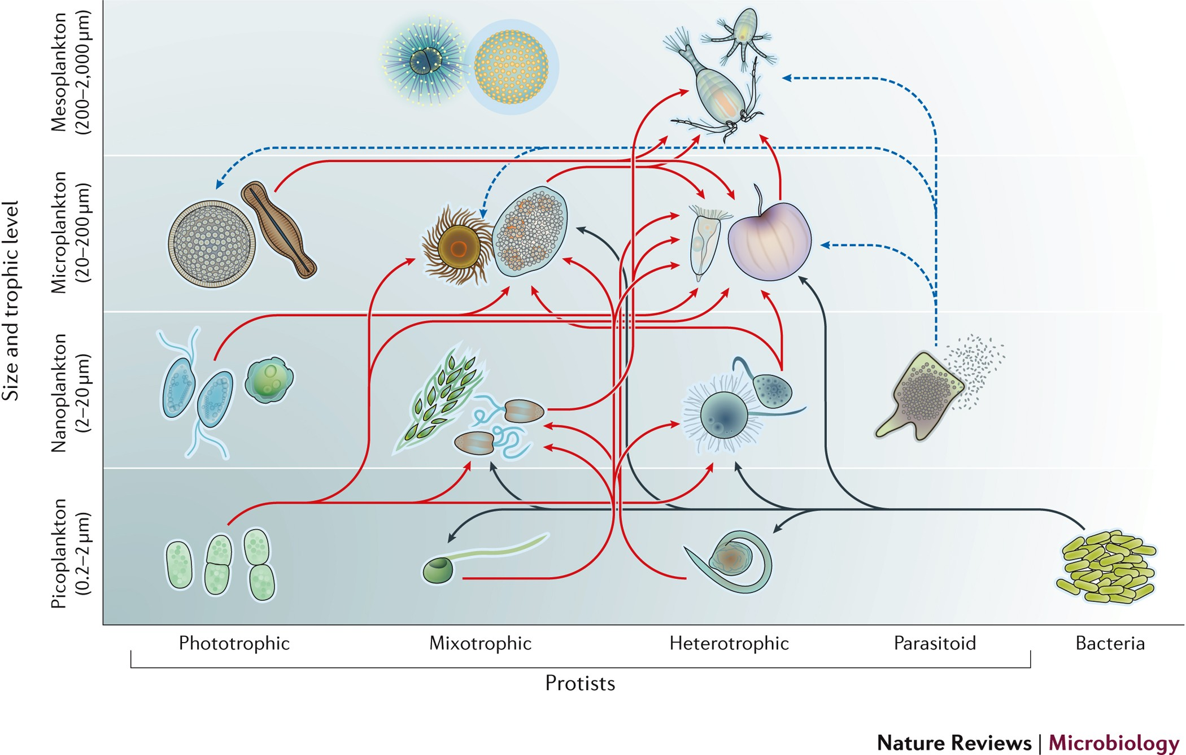
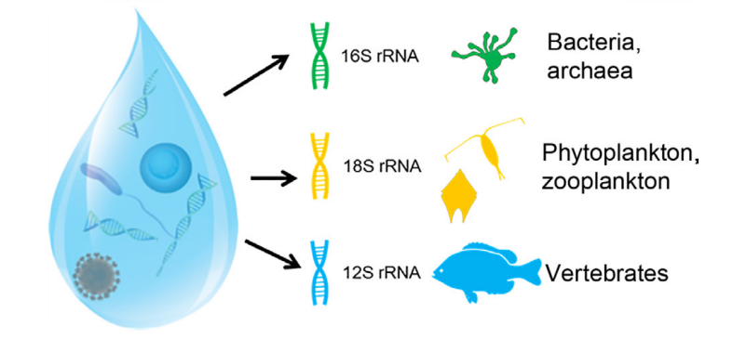
PHYTOPLANKTON
[Goodwin et al. 2019 doi.org/10.1016/B978-0-12-805052-1.00032-2]
[Caron et al. 2017 doi.org/10.1038/nrmicro.2016.160]

Slide 6
PHYTOPLANKTON
SAMPLING
HABs
CONCENTRATION
DIVERSITY
DNA EXTRACTION
Higher Specificity
Lower limits of detection
Fast detection and interpretation
Tracing
Monitoring
AMPLIFICATION
Lower Specificity
Broad range of detection
Tracing
DETECTION
APLICABILITY
MINIATURISATION
IN-FIELD DEPLOYMENT

Slide 7
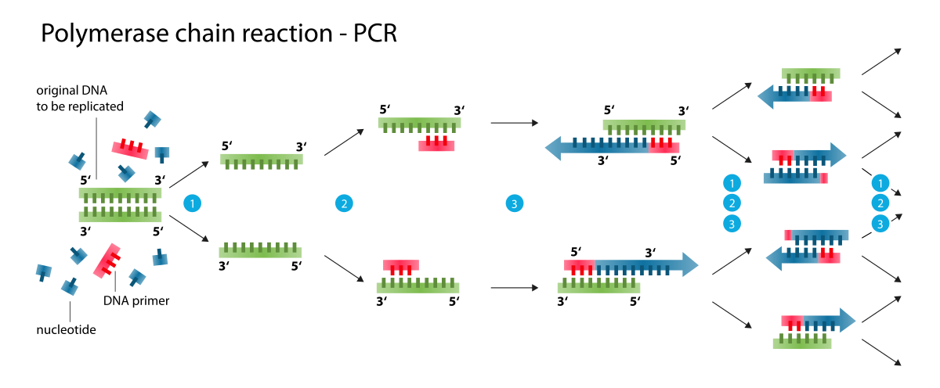
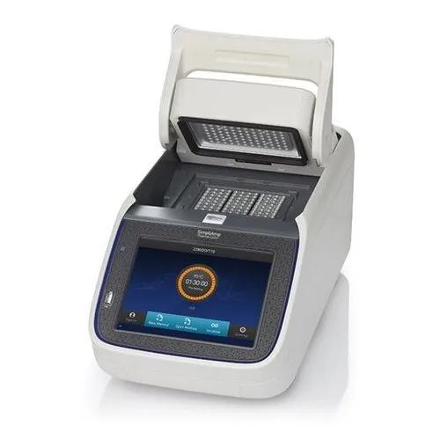
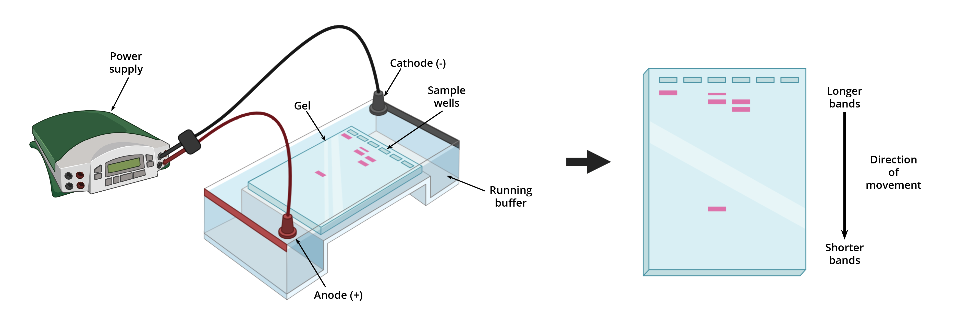
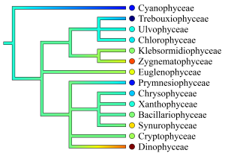
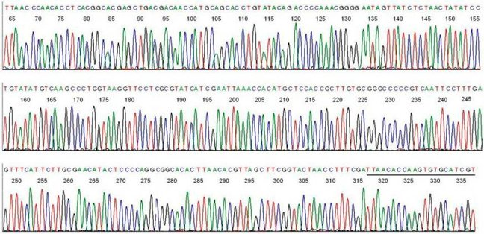
END-POINT CONVENTIONAL PCR
- Detection
- Identification
- Sequence retrival
- Barcoding
- Phylogeny
- Gene marker
- Low resolution
[https://pt.wikipedia.org; https://www.aatbio.com/catalog/gel-electrophoresis]
[https://www.ibi.vu.nl/programs/phylopars/phytoplankton]

Slide 8
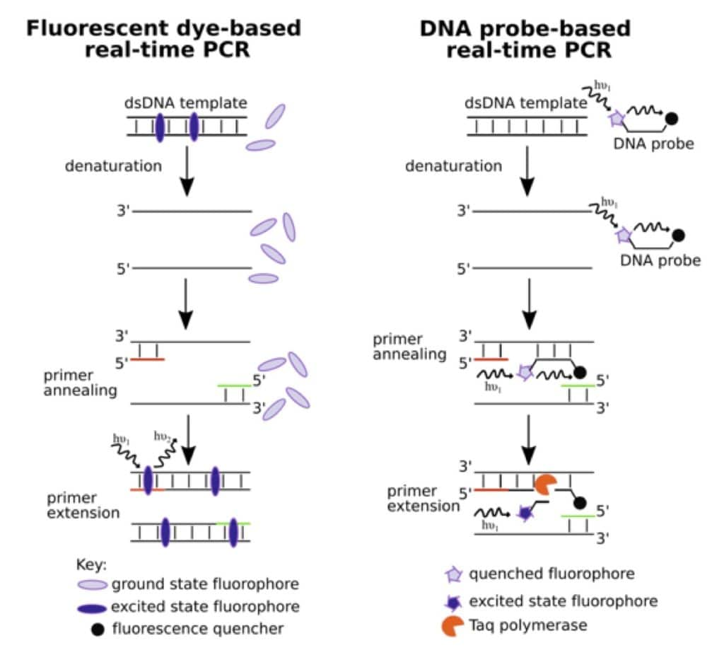
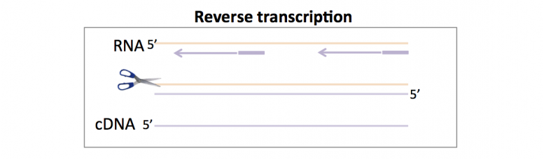
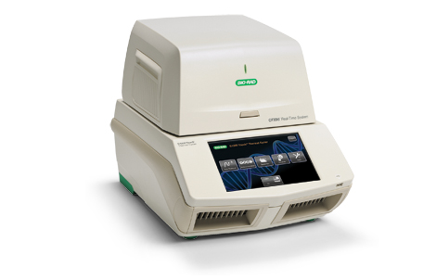
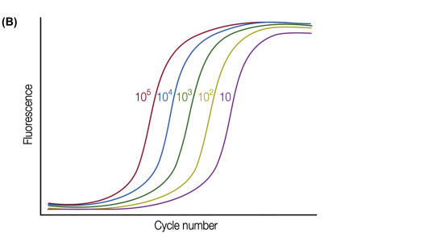
REAL-TIME PCR
- Low detection
- High specificity
- Quantification
- Portable
- Primer specific
- Species detection
- Gene copy number bias

Slide 9
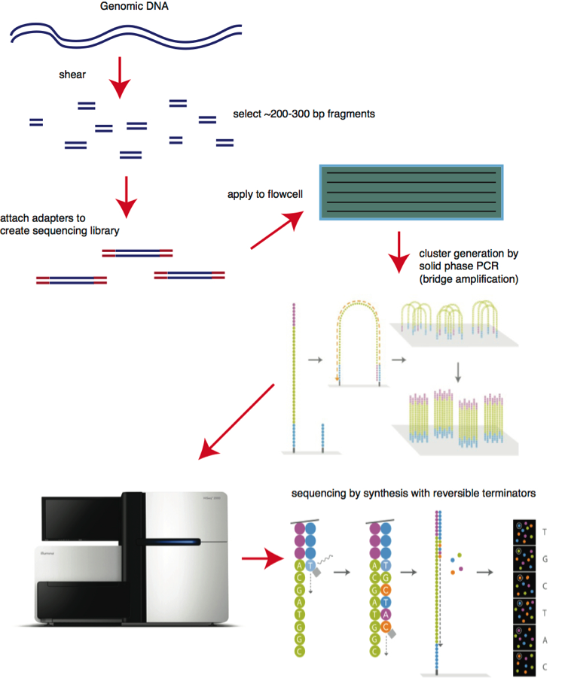
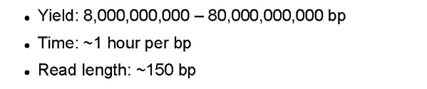
NEXT-GENERATION SEQUENCING (NGS) – Short read
- Identification
- Sequence retrival
- Large volume of data
- Metabarcoding
- All DNA sequencing (Shotgun)
- Genome
- Short read
- PCR Bias
- Large volume of data
- Gene Marker (Metabarcoding)
- Copy number
- Data base acuary dependent

Slide 10
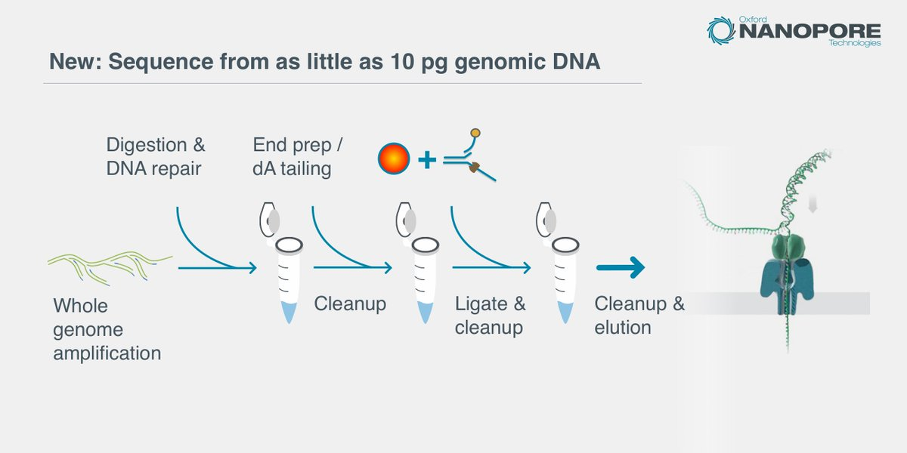
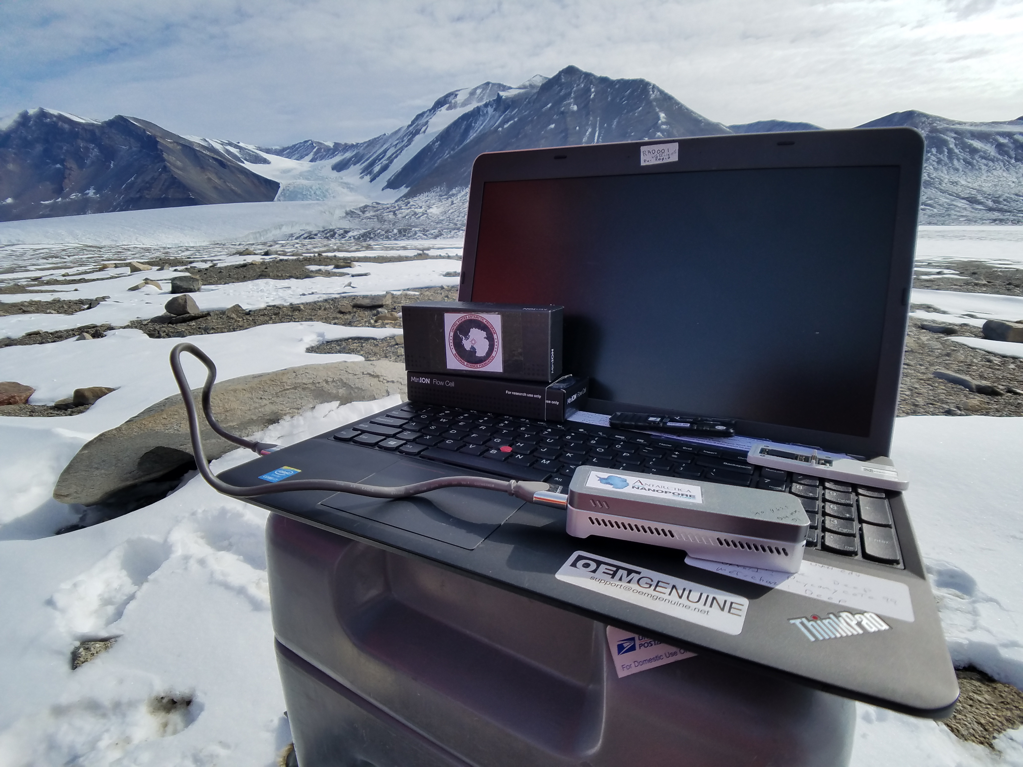
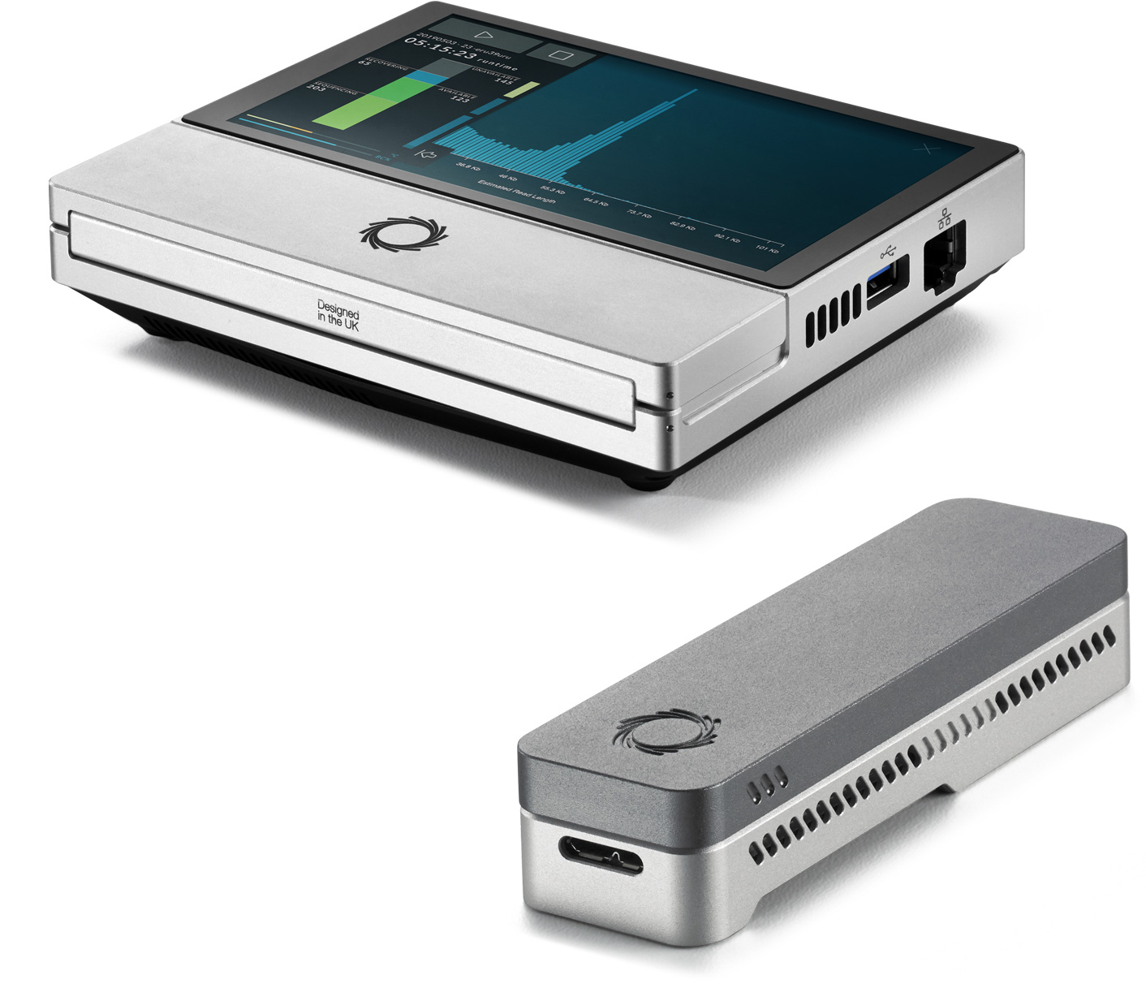
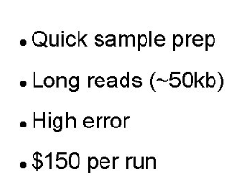
NEXT-GENERATION SEQUENCING (NGS) – Long read
- Identification
- Sequence retrival
- Large volume of data
- Metabarcoding
- All DNA sequencing
- Genome and metagenome

Slide 11
ENVISIONING MOLECULAR DATA STUDIES
Marine Biodiversity Observation Network (MBON)
“from genes to habitats”
[Goodwin et al. 2019 doi.org/10.1016/B978-0-12-805052-1.00032-2]

Slide 12
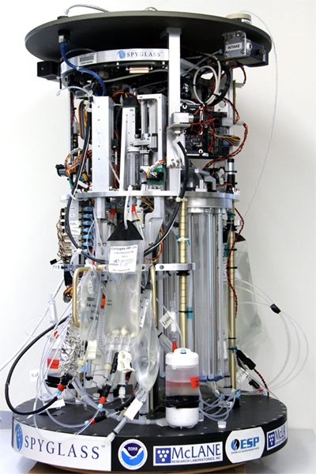
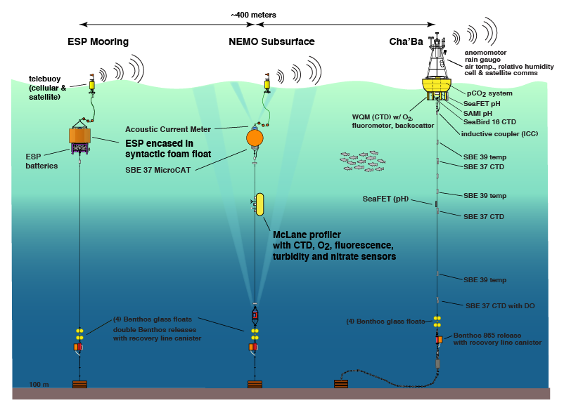
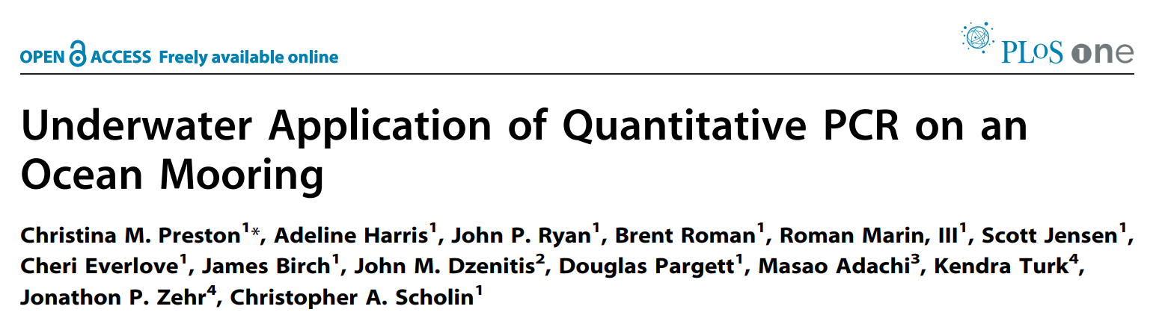
ENVIRONMENTAL SAMPLE PROCESSOR (ESP)
Real-time PCR with a qPCR module
Pseudo-nitzschia australis
- Sandwich-hybridization assay (SHA)
[http://www.nanoos.org/products/habs/real-time/about/esp.php]

Slide 13
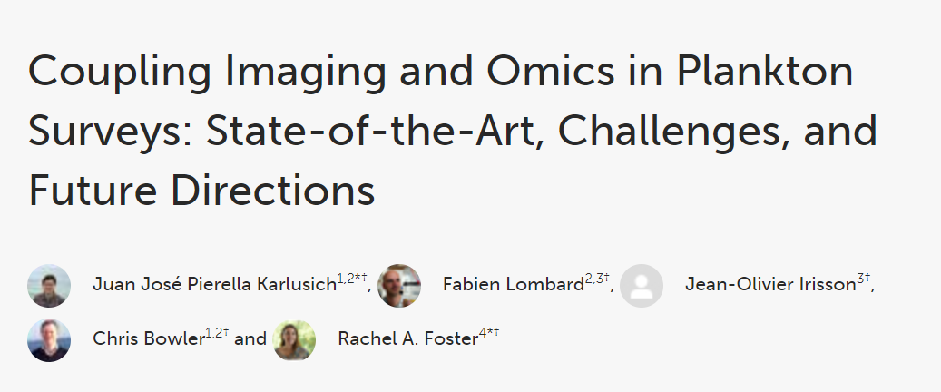
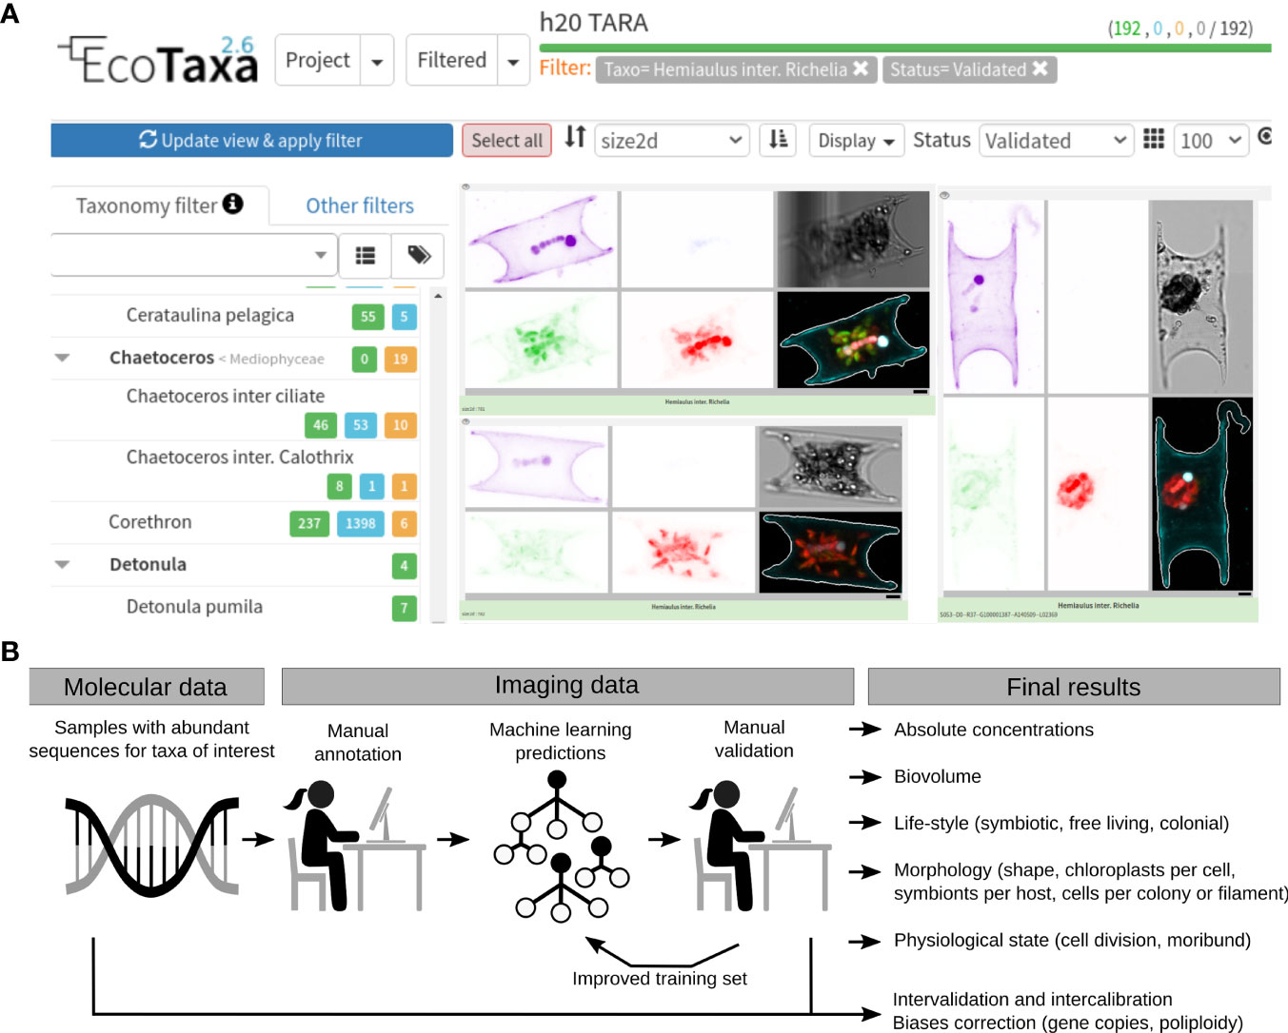
Integration of molecular and imaging datasets

Slide 14
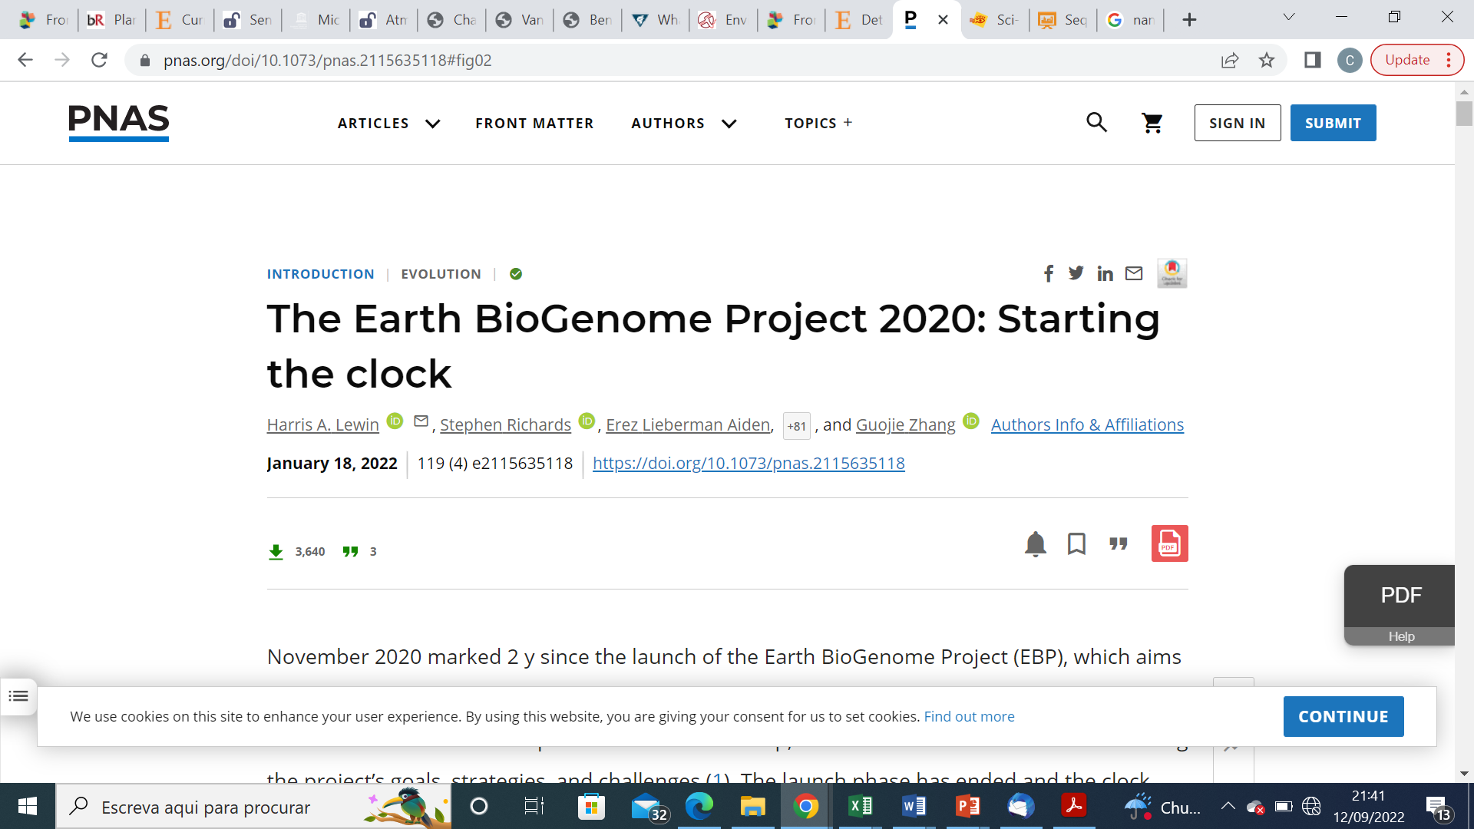
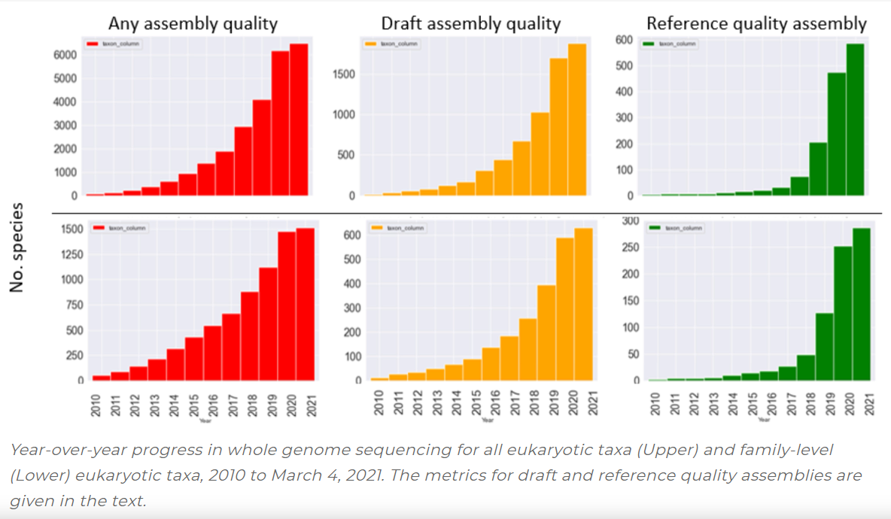
“ Aims to sequence all known eukaryotic species in a 10-y timeframe. “

Slide 15
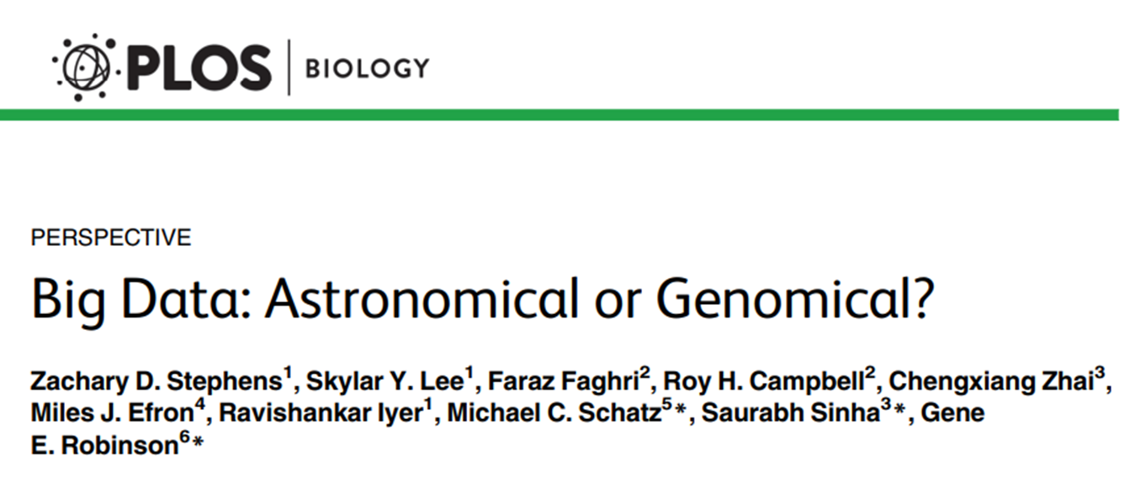

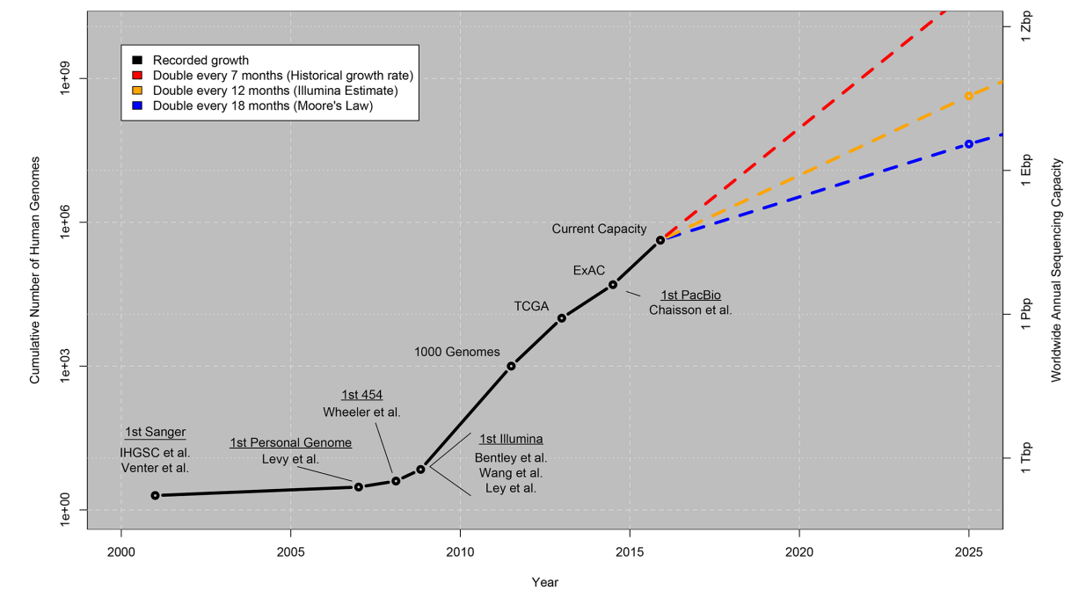
THE ERA OF DNA
Growth of DNA Sequencing
Monkey Riding a Four-Headed Beast
[Maria Primachenko]
“Genomics is a four-headed beast; considering the computational demands across the lifecycle of a dataset—acquisition, storage, distribution, and analysis—genomics is either on par with or the most demanding of the Big Data domains.“

Slide 16
THANK YOU

